Slide 1

Implementing Utilitarianism – Unexpected Consequences

Slide 2
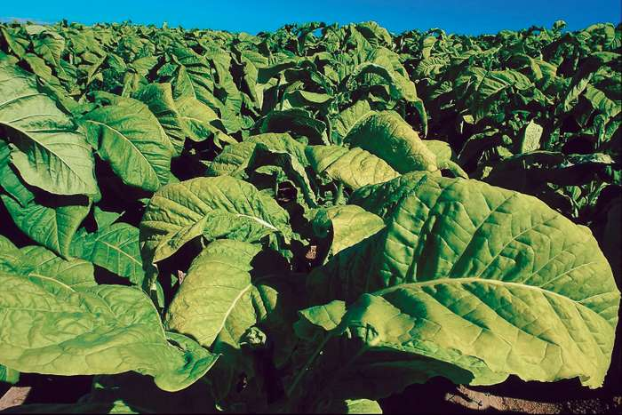
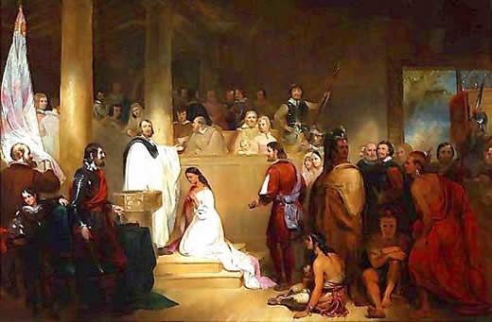
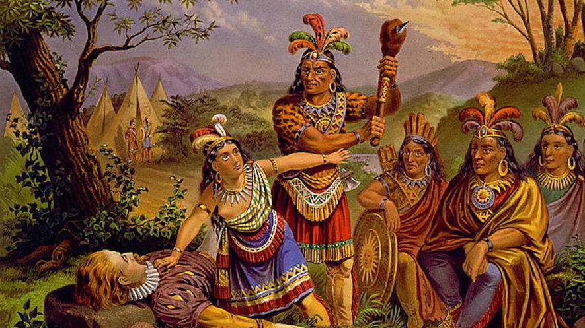
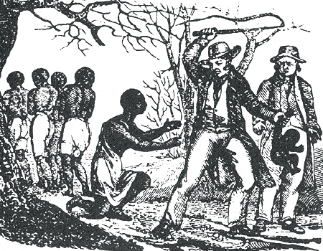
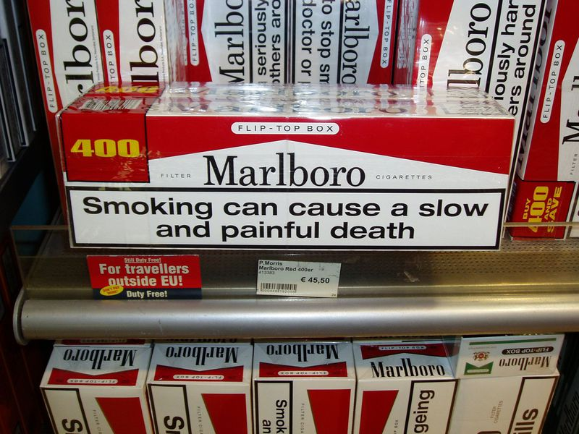
Implementing Utilitarianism
Can we determine effects?
Notes:
https://www.aoc.gov/art/historic-rotunda-paintings/baptism-Pocahontas
John Rolfe (c. 1585 – 1622)
Rolfe developed new technology – a strain of tobacco that grew well in VA and that Europeans wanted. It kept the VA colony alive. But what were some unintended consequences? (tobacco deaths today, slavery back then) Do we need to worry about unintended consequences of today’s technologies?
https://www.britannica.com/plant/tobacco-genus
https://www.smithsonianmag.com/smart-news/cigarette-warning-labels-more-graphic-180961721/
https://newsela.com/read/lib-ushistory-native-americans-virginia/id/29038/
https://www.ocf.berkeley.edu/~arihuang/academic/abg/slavery/history.html

Slide 3
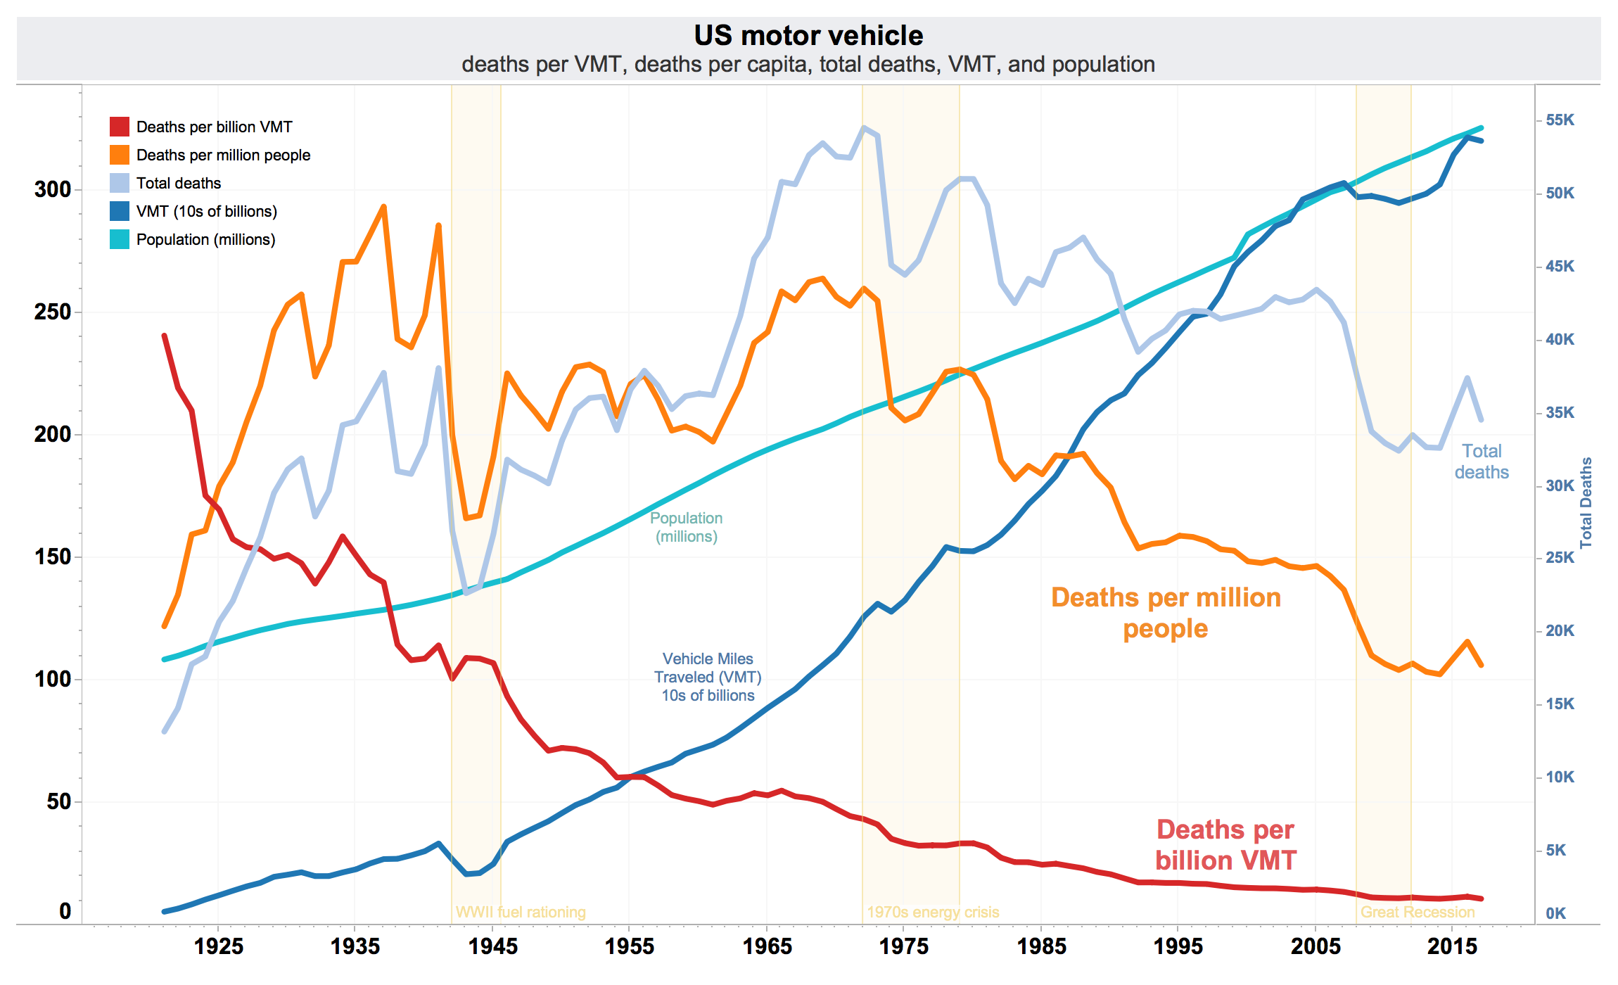
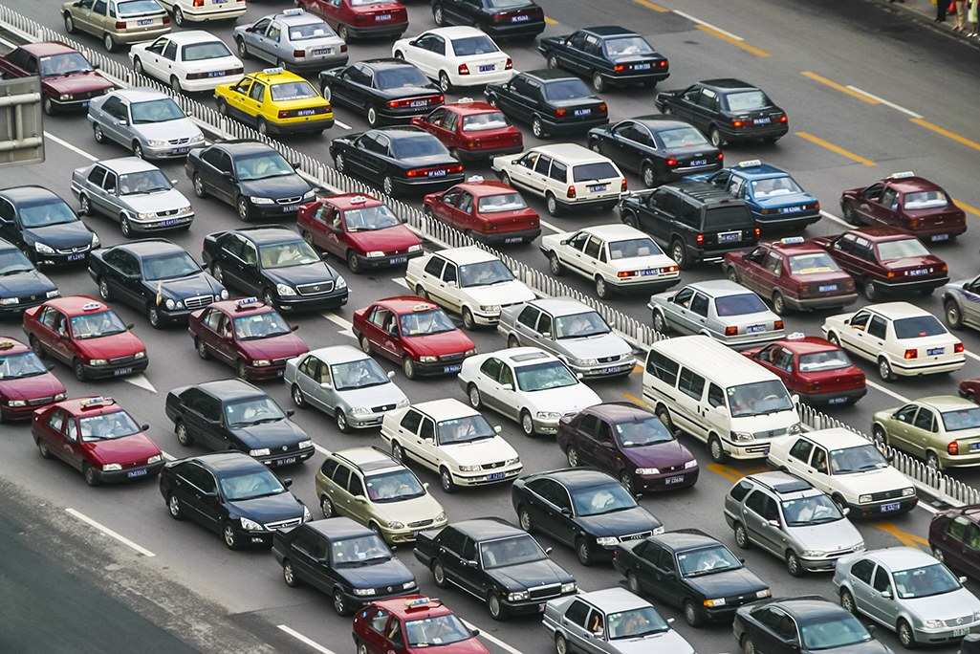
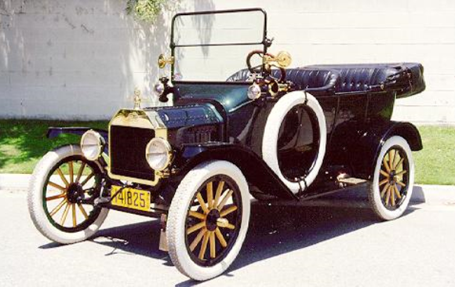
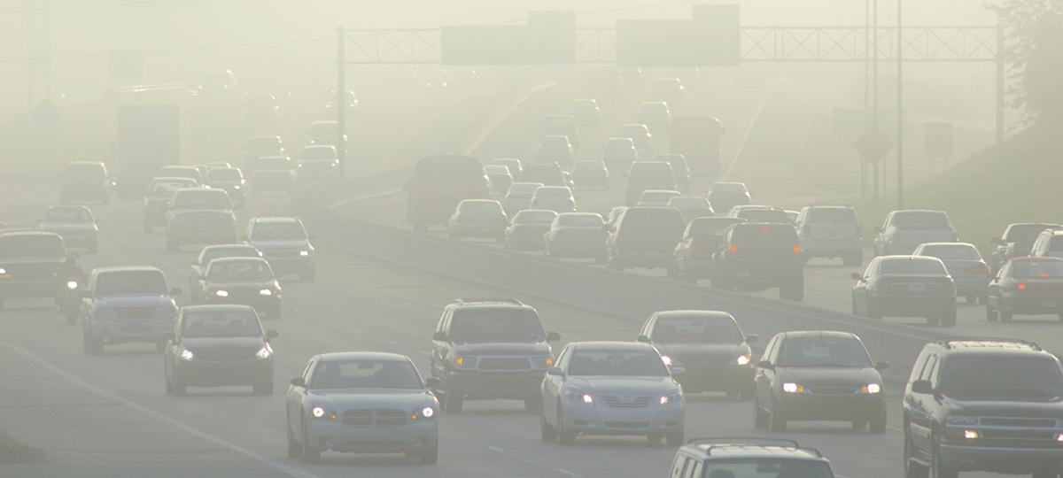
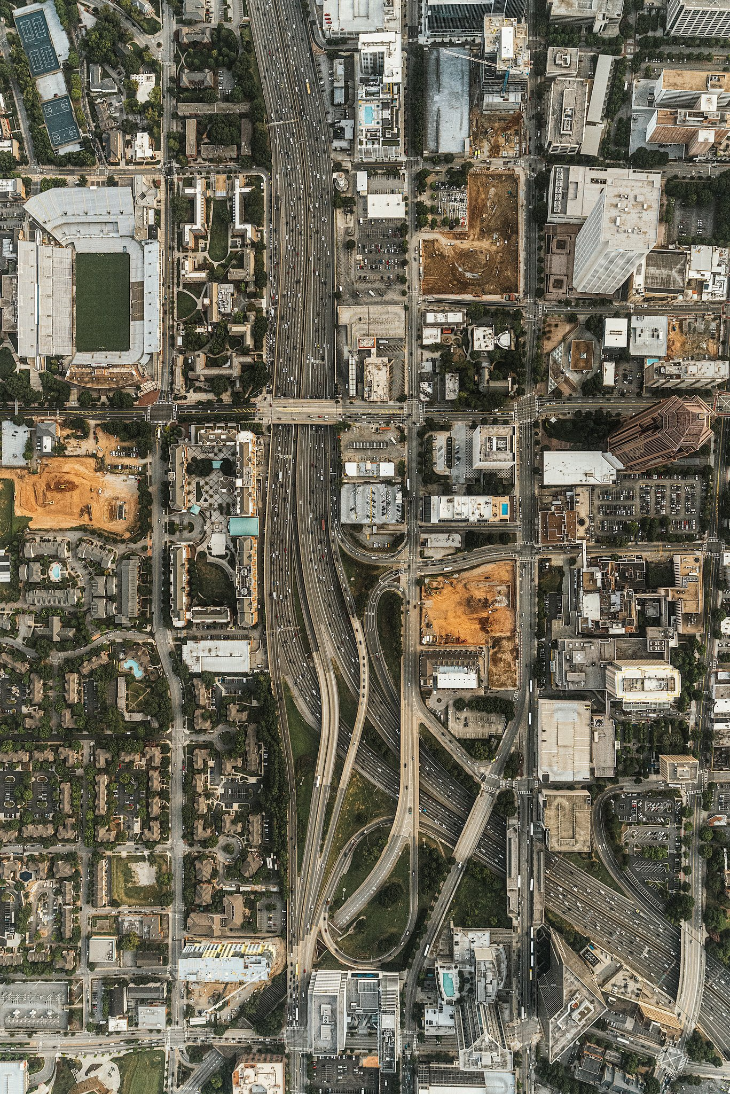
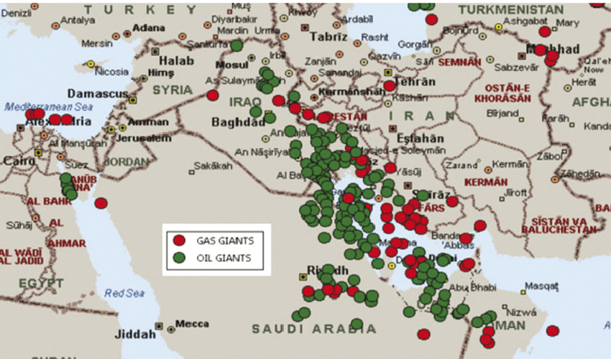
Implementing Utilitarianism
Can we determine effects?
Notes:
What have been some unintended consequences of cars? Highways were often built on top of black communities and then used to keep whites and blacks apart.
https://www.ucsusa.org/resources/vehicles-air-pollution-human-health
https://www.researchgate.net/figure/Map-of-the-giant-oil-and-gas-fields-in-the-Middle-East-Horn-2004_fig2_311573711
https://www.nytimes.com/interactive/2019/08/14/magazine/traffic-atlanta-segregation.html

Slide 4
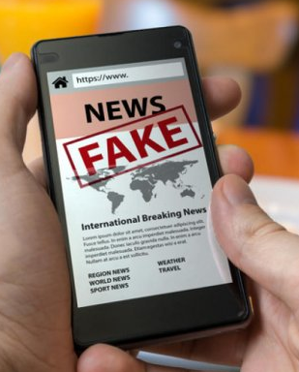
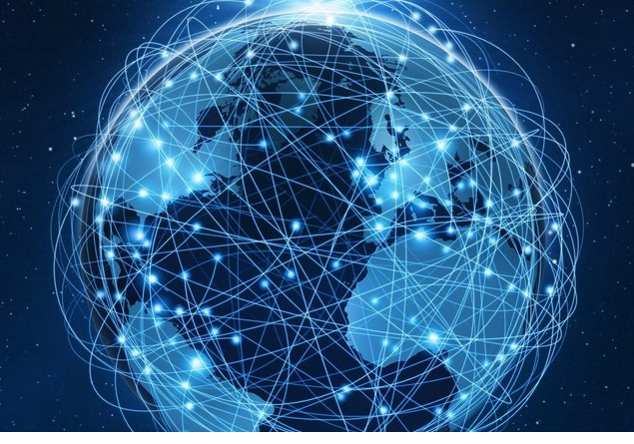
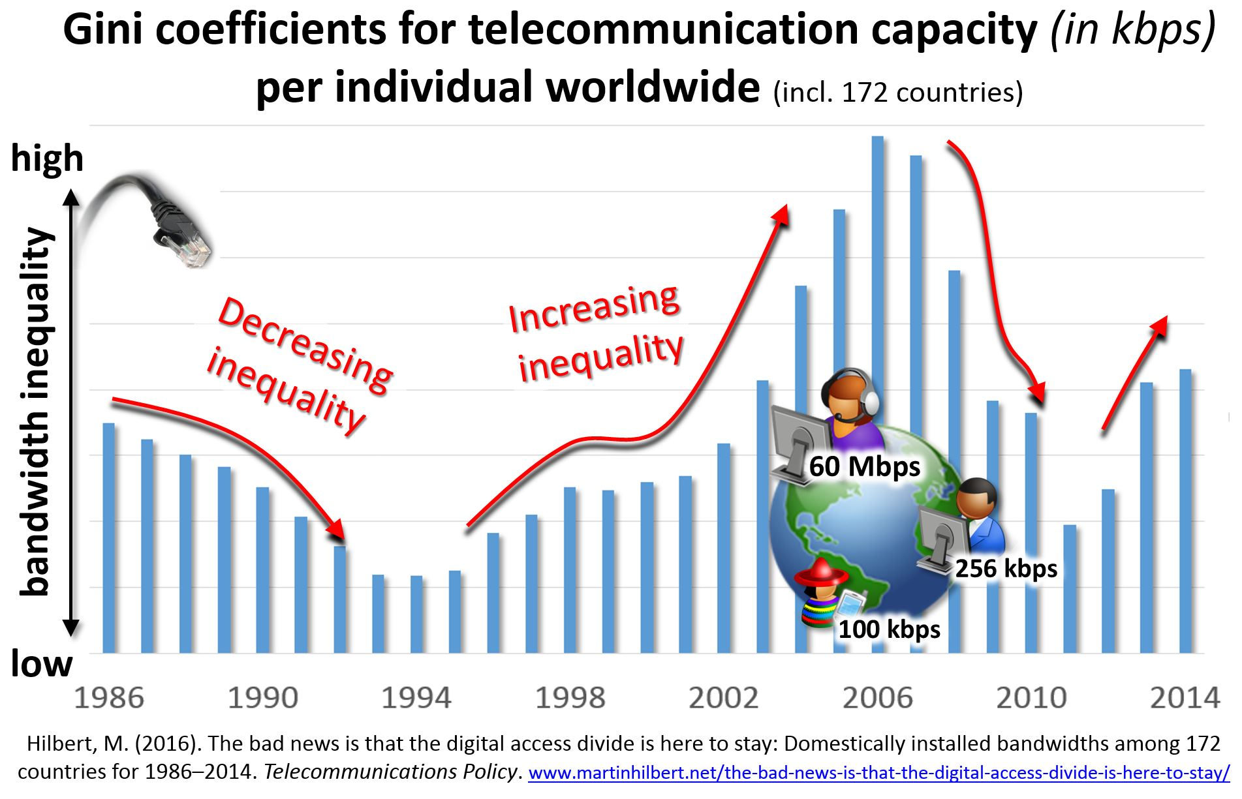
Implementing Utilitarianism
Can we determine effects?
Notes:
The internet was supposed to make it easier for everyone to have access to information. Now it spreads fake news and conspiracy theories.
https://www.deccanherald.com/national/south/coronavirus-telangana-fighting-fake-news-rumours-too-about-covid-19-814720.html
https://en.wikipedia.org/wiki/Digital_divide#/media/File:BandwidthInequality1986-2014.jpg

Slide 5
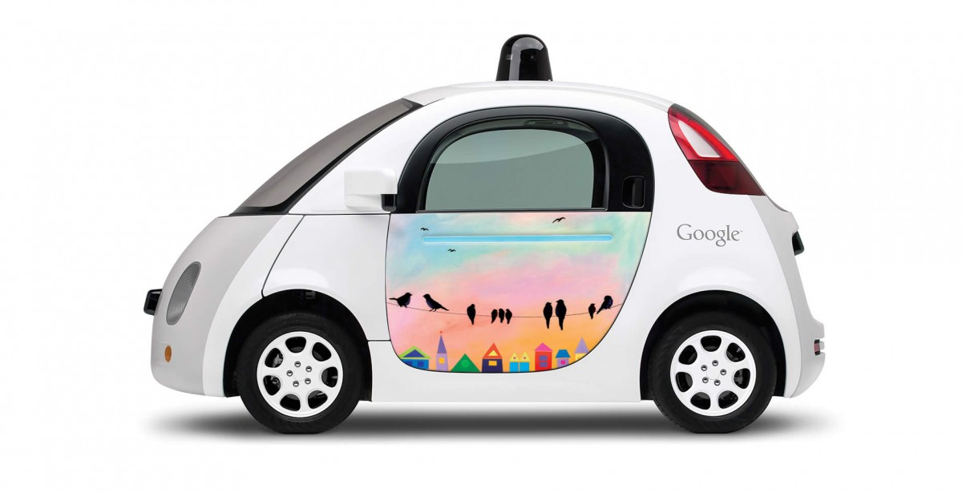
Implementing Utilitarianism
Can we determine effects?
Parking lots
Gas stations
Traffic tickets
Demand for oil
Car dealers
Car financing
Taxi drivers
Truck drivers
Privacy
Wealth concentration
https://medium.com/@DonotInnovate/73-mind-blowing-implications-of-a-driverless-future-58d23d1f338d
Notes:
Google car: https://youtu.be/nBkQQ6czRJI
Good article on this: https://medium.com/@DonotInnovate/73-mind-blowing-implications-of-a-driverless-future-58d23d1f338d
Traffic tickets can be bad because of loss of revenue to cities
No privacy – the small number of autonomous car companies will know everything about you

Slide 6
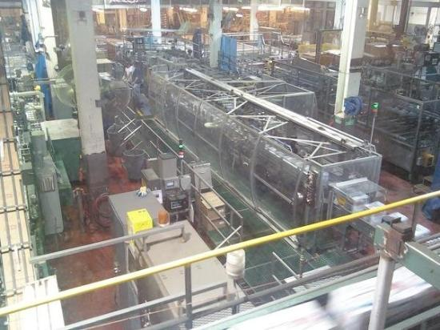
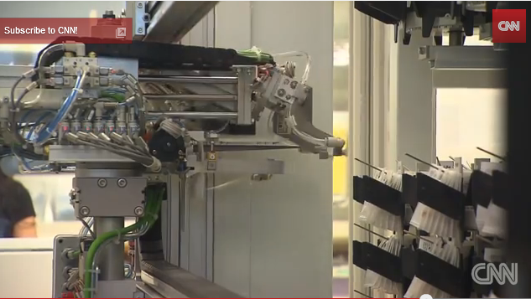
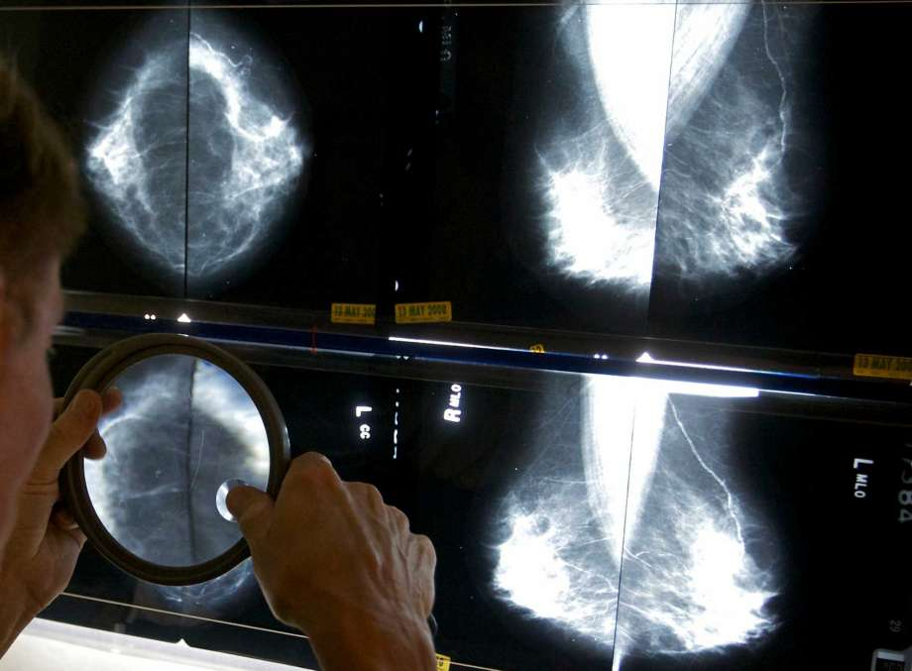
Jobs
Notes:
Fast change affects many aspects of society. Let’s look at one: jobs. EAR
Robotic pharmacist: https://www.youtube.com/watch?v=EQGSk3Lt9X0
Coors factory: Note no people. https://www.tripadvisor.com/LocationPhotoDirectLink-g33388-i23828601-Denver_Colorado.html
Google car: https://youtu.be/nBkQQ6czRJI
Software reads mammograms with 99% accuracy and fewer false positives than humans. It’s not just blue collar jobs.
https://futurism.com/artificial-intelligence-reads-mammograms-with-99-accuracy/

Slide 7
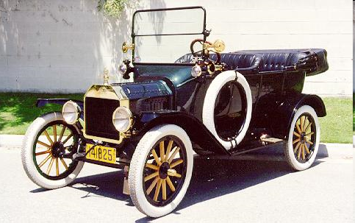
Implementing Utilitarianism
Can we determine effects?
Do we have a moral responsibility to think hard about this issue?
Notes:
https://www.aoc.gov/art/historic-rotunda-paintings/baptism-Pocahontas
John Rolfe (c. 1585 – 1622)
Rolfe developed new technology – a strain of tobacco that grew well in VA and that Europeans wanted. It kept the VA colony alive. But what were some unintended consequences? (tobacco deaths today, slavery back then) Do we need to worry about unintended consequences of today’s technologies?

